Slide 1
Module: Introduction to Cloud Computing
Upon completion of this module, you should be able to:
Define cloud computing
Describe the essential cloud characteristics
Discuss the key benefits of cloud computing
Describe the cloud service models
Describe cloud services brokerage
Describe the cloud deployment models
Notes:
This module focuses on introduction to cloud computing. It provides the definition of cloud computing, describes essential cloud characteristics, and discusses the key benefits of cloud computing. This module also describes the primary cloud service models, cloud services brokerage, and the primary cloud deployment models.

Slide 2
Lesson: Cloud Computing Overview
This lesson covers the following topics:
Definition of cloud computing
Essential characteristics of cloud computing
Key benefits of cloud computing
Notes:
This lesson covers the definition of cloud computing and describes the essential cloud characteristics. This lesson also describes the key benefits of cloud computing.

Slide 3
The Cloud Computing Phenomenon
Adoption of cloud computing is significantly rising in organizations
Cloud computing is seen as a leading “disruptive” technology in the coming decade
Cloud is driving optimization and innovation of business models in organizations
Trends like mobility, Big Data, and social media are also influencing cloud adoption
Notes:
Cloud computing is a popular subject for discussion and both organizations and individuals show a keen interest in it. Organizations are increasingly looking at the cloud as essential to their businesses and operations, and cloud adoption is rapidly becoming a strategic business decision for many. With cloud adoption rising significantly all over the globe, cloud computing is not a catchphrase that it once was. Cloud computing is seen as one of the major “disruptive” technologies of the coming decade which will significantly transform businesses, economies, and lives globally.
Estimates and forecasts reveal that cloud adoption will rise considerably in the coming years. As cloud computing evolves and spreads globally, many organizations, including enterprises, government departments, research organizations, financial institutions, and universities are either adopting cloud computing or are earnestly planning their move to cloud computing. In the surveys conducted by groups, such as Gartner, International Data Group (IDG), and North Bridge, a majority of the organizations surveyed responded that they are either identifying, or have identified the IT operations that are candidates for cloud computing. The organizations also responded that they either have a dedicated budget or should assign a significant percentage of their IT budget for cloud computing. Also, the emergence of technology trends, such as mobility, Big Data analytics, and social media is driving organizations to optimize and innovate their business models through investment in cloud computing. According to Gartner, “the adoption of the cloud is rising rapidly and there is no sign that it is going back.”

Slide 4
What is Cloud Computing?
Cloud Computing
A model for enabling ubiquitous, convenient, on-demand network access to a shared pool of configurable computing resources, (e.g., servers, storage, networks, applications, and services) that can be rapidly provisioned and released with minimal management effort or service provider interaction.
– U.S. National Institute of Standards and Technology, Special Publication 800-145
A cloud is a collection of network-accessible IT resources
Consists of shared pools of hardware and software resources deployed in data centers
Cloud model enables consumers to hire a provider’s IT resources as a service
Notes:
The National Institute of Standards and Technology (NIST)—a part of the U.S. Department of Commerce—in its Special Publication 800-145 defines cloud computing as “a model for enabling convenient, on-demand network access to a shared pool of configurable computing resources (e.g., networks, servers, storage, applications, and services) that can be rapidly provisioned and released with minimal management effort or service provider interaction.”
A cloud is a collection of IT resources, including hardware and software resources that a user (consumer) accesses over a network. A cloud infrastructure is built, operated, and managed by a cloud service provider. Cloud computing is a model that enables consumers to conveniently hire IT assets as a service from a provider’s cloud infrastructure. A cloud service is any combination of IT resources, such as network-accessible data storage and processing, fully-featured applications, and software development and deployment tools that are offered for consumption by a cloud provider. The provider maintains shared pools of the IT resources, and the resources are made available to the consumers as services over a network, such as the Internet or an intranet. Consumers themselves provision the resources from the pools, as and when required, without the need to interact with the provider during the process. The resources are returned to the pool when they are released. In general, a cloud system and its consumers employ the client-server model, which means that the consumers (the clients) send messages over a network to compute systems, which then perform operations in response to the received messages.
The IT resources that make up a cloud infrastructure are deployed in data centers. A data center is a facility that houses and maintains centralized IT systems and components including compute systems, storage systems, and network equipment. A data center also has supporting infrastructure, such as secure access, uninterruptible power source (UPS), generators, smoke detection/fire suppression, raised floors for cabling and water damage prevention, and heating, ventilation and air conditioning (HVAC) systems. The operations staff of a data center monitors operations and maintains the IT and the infrastructural equipment around the clock. A cloud data center may reside at a single physical location, or may comprise of multiple data centers that are distributed across geographical locations and are connected to each other over a network.

Slide 5
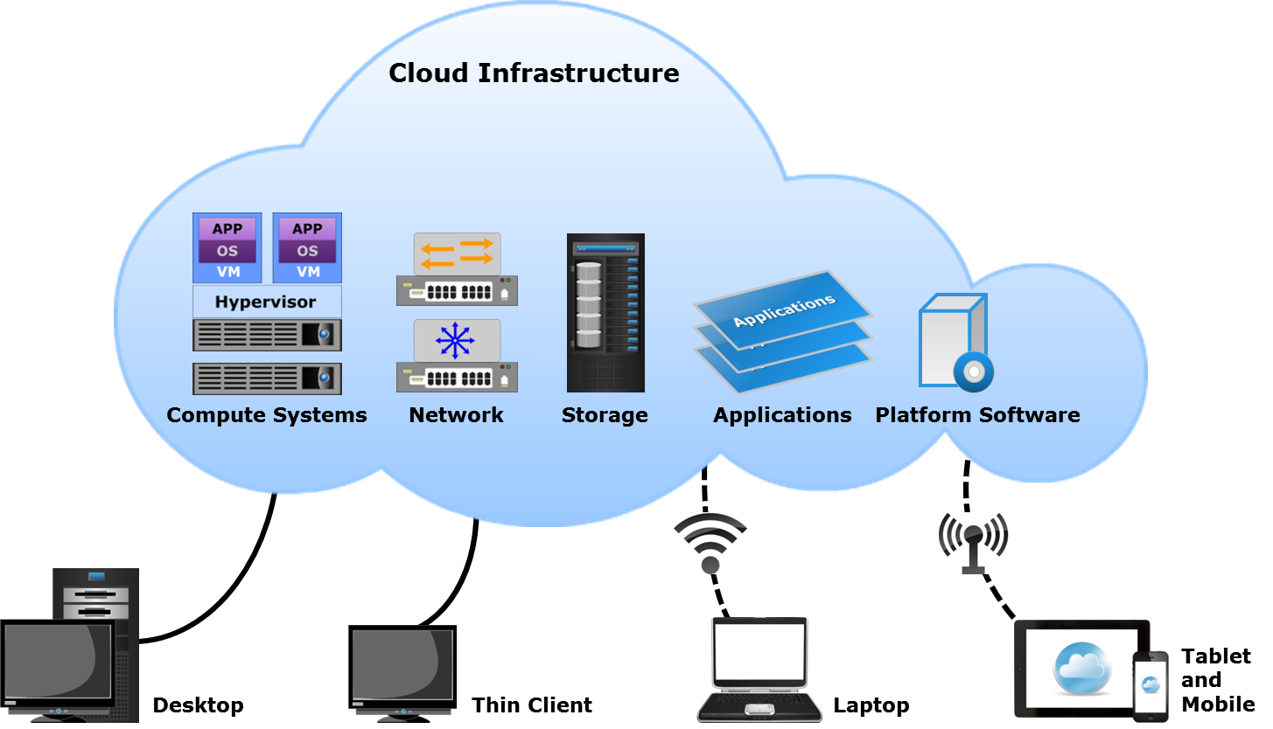
What is Cloud Computing? (Cont'd)
Notes:
The cloud model is similar to a utility service such as electricity, wherein a consumer simply plugs in an electrical appliance to a socket and turns it on. The consumer is typically unaware of how the electricity is generated or distributed and only pays for the amount of electricity used. Similarly, to the cloud consumers, the cloud is an abstraction of IT infrastructure from which they hire IT resources as services without the risks and costs associated with owning the resources. Consumers pay only for the services that they use, either based on a subscription or based on resource consumption.
Many organizations now see cloud as an extension of their IT resources procurement strategy. It may well become the predominant way in which organizations acquire and use computing technology in the future. Through cloud computing, even smaller companies can obtain required IT resources and can compete in ways that were previously expensive and often cost-prohibitive.
The figure on the slide illustrates a generic cloud computing environment, wherein various types of cloud services are accessed by consumers from different client devices over different network types. The term “cloud” originates from the cloud-like bubble that is commonly used in technical architecture diagrams to represent a system, such as the Internet, a network, or a compute cluster. However, that is not the case in cloud computing. A computing infrastructure can be classified as a cloud only if it has some specific essential characteristics, which are subsequently discussed.

Slide 6
Essential Cloud Characteristics
On-demand self-service
Broad network access
Resource pooling
Rapid elasticity
Measured service
Notes:
In SP 800-145, NIST specifies that a cloud infrastructure should have the five essential characteristics listed below:
On-demand self-service
Broad network access
Resource pooling
Rapid elasticity
Measured service
Note: This course uses the following terminology:
“Cloud service provider” or “cloud provider” or “service provider” or “provider” is an organization that provides cloud services. The provider may be an external provider or internal to the consumer organization, for example, the IT department.
“Cloud consumer” or “consumer” is an individual or an organization that is a customer of a cloud. Also, a cloud itself may be a customer of another cloud.
“Compute system” or “server” or “host” is a physical compute system that executes various platform and application software.
“Cloud infrastructure” or “cloud” is the collection of hardware and software resources that are provided as services to consumers. It also includes the hardware and software to manage the cloud itself. The cloud infrastructure has five essential characteristics as specified by NIST.

Slide 7
On-demand Self-service
On-demand Self-service
A consumer can unilaterally provision computing capabilities, such as server time and network storage, as needed automatically without requiring human interaction with each service provider.
– U.S. National Institute of Standards and Technology, Special Publication 800-145
Consumers use a web-based self-service portal to view a service catalog and request cloud services
Enables consumers to provision cloud services in a simple and flexible manner
Reduces the time needed to provision new or additional IT resources
Notes:
On-demand self-service: “A consumer can unilaterally provision computing capabilities, such as server time or networked storage, as needed automatically without requiring human interaction with each service provider.” – NIST
In cloud computing, the consumers have the ability to provision any IT resource that they require on demand from a cloud, at any time they want. Self-service means that the consumers themselves carry out all the activities required to provision the cloud resource.
To enable on-demand self-service, a cloud provider makes available a simple and user-friendly self-service portal, which is a website that allows consumers to view and order cloud services. The cloud provider publishes a service catalog on the self-service portal. The service catalog lists items, such as service offerings, service prices, service functions, request processes, and so on. A potential consumer can use the self-service portal via a browser to view the cloud services listed in the service catalog. The consumer can then place a request for the required service(s) through the self-service portal. The request gets processed automatically without human intervention from the cloud provider’s side. On-demand self service enables the consumers to order cloud services in a simple and flexible manner. For example, if a consumer requires compute systems to host applications and databases, the resources can be quickly and easily provisioned from the cloud. This eliminates several time-consuming resource acquisition and configuration processes and also the dependency on internal IT. This considerably reduces the time needed to provision new or additional IT resources. The ‘Service and Orchestration Layers’ module covers self-service portal and service catalog in detail.

Slide 8
Broad Network Access
Broad Network Access
Capabilities are available over the network and accessed through standard mechanisms that promote use by heterogeneous thin or thick client platforms, (e.g., mobile phones, tablets, laptops, and workstations).
– U.S. National Institute of Standards and Technology, Special Publication 800-145
Consumers access cloud services on any client/end-point device from anywhere over a network
Standard mechanisms support the use of heterogeneous client platforms
OSI and TCP/IP protocols
SOAP and REST web services
Notes:
Broad network access: “Capabilities are available over the network and accessed through standard mechanisms that promote use by heterogeneous thin or thick client platforms (e.g., mobile phones, tablets, laptops, and workstations).” – NIST
Consumers access cloud services on any client/end-point device from anywhere over a network, such as the Internet or an organization’s private network. For instance, a cloud application, such as a web-based document creator and editor that is accessed and used at any time over the Internet. Users can access and edit documents from any Internet-connected device, eliminating the need to install the application or any specialized client software on the device. In cloud computing, network-accessible capabilities go beyond applications. Cloud computing enables the consumers to access essentially any data center capability from any place and on any device. Cloud solutions provide access to data, to compute systems, to storage, and to facilities such as data backup and recovery. Cloud services are accessed over a network from a broad range of end-point devices, such as desktops, laptops, tablets, mobile phones, and thin clients. The devices may have heterogeneous underlying hardware and software platforms.
Any network communication involves the use of the standard network specifications, the protocols, and the mechanisms that are detailed in the Open Systems Interconnection (OSI) conceptual model and the TCP/IP protocol suite. Each of the two networking models specifies a set of abstraction layers, wherein each layer is a set of network-related entities, functions, and protocols, and provides services to the layer above it. The top-most layer in each model is the Application Layer, which is the layer that applications interact with to exchange data with other applications over a network connection.
Applications typically use the Hypertext Transfer Protocol (HTTP) which is an Application Layer protocol for data transmission to exchange data and communicate with each other over a network. Different applications are developed in different programming languages, which may result in their inability to interpret the data of other applications and restrict their network communication with each other. Therefore, software developers use web services to enable applications to communicate with each other over a network.
(Cont'd)

Slide 9
Broad Network Access
Broad Network Access
Capabilities are available over the network and accessed through standard mechanisms that promote use by heterogeneous thin or thick client platforms, (e.g., mobile phones, tablets, laptops, and workstations).
– U.S. National Institute of Standards and Technology, Special Publication 800-145
Consumers access cloud services on any client/end-point device from anywhere over a network
Standard mechanisms support the use of heterogeneous client platforms
OSI and TCP/IP protocols
SOAP and REST web services
Notes:
The World Wide Web Consortium (W3C) defines a web service as “a software system designed to support interoperable machine-to-machine interaction over a network”. Web services are self-contained application components that enable applications to communicate using open protocols. Web services typically use Extensible Markup Language (XML) for formatting data. The data itself is transmitted using HTTP. Most programming languages support the use of XML and enable applications to interpret XML data. This allows different applications to communicate through a web service and eliminates the dependency on a specific programming language. Web services allow software systems to communicate and exchange data without the need to know each other’s internal structure. Web services do not have a user interface as they are used by applications through procedure calls. Web services are primarily based on either the Simple Object Access Protocol (SOAP) specification or the Representational State Transfer (REST) architectural style. A detailed discussion of all the network and web service models, the protocols, and the mechanisms is beyond the scope of this course. However, the ‘Service and Orchestration Layers’ module covers REST and SOAP in brief.

Slide 10
Resource Pooling
Resource Pooling
The provider’s computing resources are pooled to serve multiple consumers using a multi-tenant model, with different physical and virtual resources dynamically assigned and reassigned according to consumer demand. There is a sense of location independence in that the customer generally has no control or knowledge over the exact location of the provided resources but may be able to specify location at a higher level of abstraction (e.g., country, state, or datacenter). Examples of resources include storage, processing, memory, and network bandwidth.
– U.S. National Institute of Standards and Technology, Special Publication 800-145
Enables providers to improve resource utilization and to flexibly provision and reclaim resources
Notes:
Resource pooling: “The provider’s computing resources are pooled to serve multiple consumers using a multi-tenant model, with different physical and virtual resources dynamically assigned and reassigned according to consumer demand. There is a sense of location independence. In that the customer generally has no control or knowledge over the exact location of the provided resources but may be able to specify location at a higher level of abstraction (e.g., country, state, or datacenter). Examples of resources include storage, processing, memory, and network bandwidth.” – NIST
In cloud computing, resources such as storage, processor, memory, and network bandwidth are pooled to serve multiple consumers. Resource pooling enables IT resources to be dynamically assigned, released, and reassigned according to consumer demand. This, in turn, enables cloud providers to achieve high levels of resource utilization and to flexibly provision and reclaim resources. Consumers can provision resources from the pool as required and can release a resource when it is no longer required. Upon release, the resource is returned to the pool and made available for reallocation. For example, the storage capacities of multiple storage systems can be combined to obtain a single large storage pool from which storage can be provisioned to multiple consumers. The same can be done with compute system processors and with network bandwidth. This is known as multi-tenant model.
Multi-tenancy refers to an architecture in which multiple independent consumers (tenants) are serviced using a single set of resources. A tenant could be an individual user, a user group, or an organization. The multi-tenant model enables a provider to offer services at a lower cost through economy of scale. This is similar to tenants sharing a physical building, such as a hotel. Just as the building may be occupied by multiple residents or tenants, each with their own private space, a multi-tenant cloud infrastructure contains pools of different resource types that serve multiple independent consumers (tenants).
(Cont'd)

Slide 11
Resource Pooling
Resource Pooling
The provider’s computing resources are pooled to serve multiple consumers using a multi-tenant model, with different physical and virtual resources dynamically assigned and reassigned according to consumer demand. There is a sense of location independence in that the customer generally has no control or knowledge over the exact location of the provided resources but may be able to specify location at a higher level of abstraction (e.g., country, state, or datacenter). Examples of resources include storage, processing, memory, and network bandwidth.
– U.S. National Institute of Standards and Technology, Special Publication 800-145
Enables providers to improve resource utilization and to flexibly provision and reclaim resources
Notes:
As with the physical building, resource pooling and sharing of the cloud resources lower the cost of services for consumers. Consumers only pay for the resources that they use.
Though the consumers share the resources, the activity and data of one consumer is effectively isolated from that of other consumers. Unlike the physical building analogy with the pooling of cloud resources, the consumer generally has no knowledge or control over the exact location of the provided resources. Virtualization is the key enabling technology for resource pooling and multi-tenancy in the cloud. Virtualization and resource pools are covered in detail in the ‘Virtual Layer’ module.
Note: Although virtualization enables the cloud characteristics of resource pooling and rapid elasticity, it is possible to build a cloud infrastructure and offer cloud services without the use of virtualization. However, the use of virtualization provides several key benefits that simplify resource pooling , resource provisioning, and cloud infrastructure management.

Slide 12
Rapid Elasticity
Rapid Elasticity
Capabilities can be elastically provisioned and released, in some cases automatically, to scale rapidly outward and inward commensurate with demand. To the consumer, the capabilities available for provisioning often appear to be unlimited and can be appropriated in any quantity at any time.
– U.S. National Institute of Standards and Technology, Special Publication 800-145
Consumers can adapt to variations in workloads and maintain required performance levels
Consumers may be able to avoid excessive costs from over-provisioning resources
Notes:
Rapid elasticity: “Capabilities can be rapidly and elastically provisioned, in some cases automatically, to scale rapidly outward and inward commensurate with demand. To the consumer, the capabilities available for provisioning often appear to be unlimited and can be appropriated in any quantity at any time.” – NIST
Rapid elasticity refers to the ability for consumers to quickly request, receive, and later release as many resources as needed. The characteristic of rapid elasticity gives consumers a sense of availability of unlimited IT resources that can be provisioned at any time. It enables consumers to adapt to the variations in workloads by quickly and dynamically expanding (scaling outward) or reducing (scaling inward) IT resources, and to proportionately maintain the required performance level. For example, an organization might require double the processing capacity for a specific duration to enable the deployed application to handle increased workload. For the remaining period, the organization might want to release the idle IT resources to save costs. The workload variations may be seasonal, exponential, transient, and so on. Consumers can leverage the rapid elasticity characteristic of a cloud infrastructure when they have such variations in workloads and IT resource requirements. This may enable them to avoid the excessive costs from over-provisioning the resources. When resources are over-provisioned to provide capacity to meet the peak demand, the capacity may not used in non-peak periods.
Dynamic resource provisioning can be manual or automated. It requires monitoring of resource usage, and provisioning additional resources, as and when required, to meet the demand. In cloud systems, elastic provisioning is typically done through automation, since carrying out the tasks manually can be a time-consuming, cumbersome, and error-prone.
Note: Scalability generally refers to the ability to add resources to an IT infrastructure to suitably match the growth in workload and capacity requirements. Scalability is typically planned in nature, with appropriate estimates of overheads and requirements usually in place. For example, an organization may estimate the number by which the users of an application may grow, and may add storage and compute periodically to meet the increase in storage capacity and processing demands.
(Cont'd)

Slide 13
Rapid Elasticity
Rapid Elasticity
Capabilities can be elastically provisioned and released, in some cases automatically, to scale rapidly outward and inward commensurate with demand. To the consumer, the capabilities available for provisioning often appear to be unlimited and can be appropriated in any quantity at any time.
– U.S. National Institute of Standards and Technology, Special Publication 800-145
Consumers can adapt to variations in workloads and maintain required performance levels
Consumers may be able to avoid excessive costs from over-provisioning resources
Notes:
Scaling can be done in two ways: vertically or horizontally. Vertical scaling (or scaling up) involves adding more resources to a single component in an IT infrastructure, for example, adding storage disks to a storage array or adding memory to a compute system. Horizontal scaling (or scaling out) involves adding more components to an IT infrastructure, for example, adding a storage array or a compute system to the IT infrastructure.

Slide 14
Measured Service
Measured Service
Cloud systems automatically control and optimize resource use by leveraging a metering capability at some level of abstraction appropriate to the type of service (e.g., storage, processing, bandwidth, and active user accounts). Resource usage can be monitored, controlled, and reported, providing transparency for both the provider and consumer of the utilized service.
– U.S. National Institute of Standards and Technology, Special Publication 800-145
Enables billing of cloud services
Resource monitoring helps providers with capacity and service planning
Notes:
Measured service: “Cloud systems automatically control and optimize resource use by leveraging a metering capability at some level of abstraction appropriate to the type of service (e.g., storage, processing, bandwidth, and active user accounts). Resource usage can be monitored, controlled, and reported, providing transparency for both the provider and consumer of the utilized service.” – NIST
A cloud infrastructure has a metering system that generates bills for the consumers based on the services used by them. The metering system continuously monitors resource usage per consumer, and provides reports on resource utilization. For example, the metering system monitors utilization of processor time, network bandwidth, and storage capacity. It also provides information about the current demand on the cloud and helps cloud providers with capacity and service planning. The monitoring of resource usage helps in identifying when additional resources need to be dynamically provisioned (or released) to meet workloads. This supports the cloud characteristic of rapid elasticity. Metering provides consumers with a better sense of resource consumption and provides transparency in billing, and in verifying that service levels were met. Resource monitoring and billing are covered in ‘Service and Orchestration Layers’ module.

Slide 15
Cloud Computing Benefits
Benefit | Description
Business agility | Enables quick resource provisioning Facilitates innovation Reduces time-to-market
Reduces IT costs | Reduces up-front capital expenditure (CAPEX) Improves resource utilization Reduces energy and space consumption
High availability | Ensures resource availability based on consumer’s requirements Enables fault tolerance
Notes:
The key benefits of cloud computing are as follows:
Business agility: In a traditional environment, the process of acquiring new or additional IT resources might comprise rigid procedures and approvals. As a result, the resource acquisition process may take a long time, which in turn can delay operations and can increase time-to-market. Cloud computing provides the capability to provision IT resources quickly and at any time, thereby considerably reducing the time required to deploy new applications and services. This enables businesses to reduce the time-to-market and to respond more quickly to changing market conditions. Agility also enables rapid development and experimentation that, in turn, facilitates innovation which is essential for research and development, discovery of new markets and revenue opportunities, creating new customer segments, and the development of new products.
Reduced IT costs: In a traditional environment, resources are often acquired and dedicated to specific business applications. Also, to the extent allowed by budget, resources are provisioned to accommodate the maximum estimated or peak usage requirements of the application. These practices frequently result in higher up-front costs, the creation of IT silos, the underutilization of resources, and an increase in energy consumption. Cloud computing enables consumers to hire any required IT resources based on pay-per-use or subscription pricing. This reduces a consumer’s IT capital expenditure (CAPEX) as investment is required only for the resources needed to access the cloud services. Also, the consumer hires only those resources from the cloud that are required, thereby eliminating silos and underutilized resources. Additionally, the expenses associated with IT infrastructure configuration, management, floor space, power, and cooling are reduced. Thus, cloud adoption has the potential to lower the total cost of ownership (TCO) for a consumer.
High availability: Cloud computing has the ability to ensure resource availability at varying levels depending on the consumer’s policy and application priority. Redundant infrastructure components (compute systems, network paths, and storage equipment, along with clustered software) enable fault tolerance for cloud deployments. These techniques can encompass multiple datacenters located in different geographic regions, which prevents data unavailability due to regional failures.

Slide 16
Cloud Computing Benefits (Cont'd)
Benefit | Description
Business continuity | Reduces impact of downtime Example: Cloud-based backup
Flexible scaling | Enables scaling of resources to meet demand Unilateral and automatic resource scaling
Flexibility of access | Enables access to services from anywhere Eliminates dependency on a specific end-point device
Notes:
Business continuity: It is possible for IT services to be rendered unavailable due to causes, such as natural disasters, human error, technical failures, and planned maintenance. The unavailability of IT services can lead to significant financial losses to organizations and may also affect their reputations. However, having a remote secondary site for disaster recovery involves additional capital expenditure and administrative overheads. Through the use of cloud business continuity solutions, an organization can mitigate the impact of downtime and can recover from outages that adversely affect business operations. For example, an organization may use cloud-based backup for maintaining additional copies of their data, which can be retrieved in the event of an outage. Also, an organization can save on the capital expenses required for implementing a backup solution for their IT infrastructure.
Flexible scaling: Organizations may have the need for additional IT resources at times when workloads are greater. However, they would not want to incur the capital expense of purchasing the additional compute systems and then having idle compute systems on the floor when not required, which could be the case most of the time. They would also want to release the compute resources after the task is completed. In cloud computing, consumers can unilaterally and automatically scale IT resources to meet workload demand. This is significantly more cost-effective than buying new IT resources that are only used for a short time or only during specific periods.
Flexibility of access: In a traditional environment, IT resources are accessed from dedicated devices, such as a desktop or a laptop. For example, an application has to be installed on the end-point device in order to be used. In this environment, it is usually not possible to access the application if the user is away from the device where it is installed. In cloud computing, applications and data reside centrally and are accessed from anywhere over a network from any device, such as desktop, mobile, thin client, and so on. This eliminates a consumer’s dependency on a specific end-point device. This also enables Bring Your Own Device (BYOD), whereby employees are allowed to use non-company devices as business machines. BYOD and thin clients create an opportunity to reduce acquisition and operational costs.

Slide 17
Cloud Computing Benefits (Cont'd)
Benefit | Description
Application development and testing | Enables application development and testing at a greater scale Enables testing on multiple platforms
Simplified infrastructure management | Consumers manage only those resources that are required to access cloud services
Increased collaboration | Enables sharing and simultaneous access of resources and information
Masked complexity | Intricacies of IT operations are hidden from end users
Notes:
Application development and testing: Developing and testing new applications in the production environment is risky as it may impact the currently live applications. Therefore, applications are typically developed and tested on dedicated compute systems that are isolated from the production environment. Although, most of the functionalities can be tested in such environments, it may not be possible to test for scalability. Also, organizations have to invest in procuring IT resources to support application development. Typically, the developed applications are tested on wide range of hardware and software platforms, due to which organizations need to invest in and maintain multiple platforms for development and testing. In such cases, organizations may use IT resources from a cloud provider for the development and testing of applications. Also, organizations can create compute systems of different hardware and software configurations to test applications under different environments. Organizations can also speed up application delivery, while meeting the budget and time-to-market requirements.
Simplified Infrastructure Management: In a traditional environment, an organization’s IT department has to manage a wide range of hardware and software resources. The tasks involve configuration, applying the latest patches and updates, and carrying out upgrades and replacements. Furthermore, workloads and manpower requirements increase with the size of the IT infrastructure. When an organization uses cloud services, their infrastructure management tasks are reduced to managing only those resources that are required to access the cloud services. The cloud infrastructure is managed by the cloud service provider and tasks such as software updates and renewals are handled by the cloud provider. The provider ensures that the cloud infrastructure remains modern and up-to-date with consumer requirements.
(Cont'd)

Slide 18
Cloud Computing Benefits (Cont'd)
Benefit | Description
Application development and testing | Enables application development and testing at a greater scale Enables testing on multiple platforms
Simplified infrastructure management | Consumers manage only those resources that are required to access cloud services
Increased collaboration | Enables sharing and simultaneous access of resources and information
Masked complexity | Intricacies of IT operations are hidden from end users
Notes:
Increased collaboration: Cloud computing enables collaboration between disparate groups of people by allowing them to share resources and information and access them simultaneously from any location. For example, employees in an organization can place a document centrally in the cloud enabling them to view and work on it at the same time. This eliminates the need to send files back and forth via email.
Masked complexity: Cloud computing provides a way for organizations to mask some of the intricacies of their IT operations from the end users. This helps in attracting a broader range of end users and enables them to use the cloud services without requiring sophisticated knowledge of the services. Cloud computing also enables an organization to enhance the services without increasing the level of knowledge necessary to use the service. For example, an organization can use the cloud to implement a document printing service, enabling users to print documents from any location without having to configure the service and the printers. Also, the service can be managed and upgraded without end-user participation.

Slide 19
Lesson Summary
During this lesson the following topics were covered:
Definition of cloud computing
Essential cloud characteristics
Cloud computing benefits
Notes:
This lesson covered the definition of cloud computing and described the essential cloud characteristics: on-demand self-service, broad network access, resource pooling, rapid elasticity, and measured service. This lesson also described the key benefits of cloud computing.

Slide 20
Lesson: Cloud Service Models and Cloud Services Brokerage
This lesson covers the following topics:
Infrastructure as a Service
Platform as a Service
Software as a Service
Cloud services brokerage
Notes:
This lesson covers the three primary cloud service models: Infrastructure as a Service, Platform as a Service, and Software as a Service. This lesson also covers cloud services brokerage.

Slide 21
Introduction to Cloud Service Models
A cloud service model specifies the services and the capabilities provided to consumers
NIST specifies three primary cloud service models:
Infrastructure as a Service (IaaS)
Platform as a Service (PaaS)
Software as a Service (SaaS)
Notes:
A cloud service model specifies the services and the capabilities that are provided to consumers. In SP 800-145, NIST classifies cloud service offerings into the three primary models listed below:
Infrastructure as a Service (IaaS)
Platform as a Service (PaaS)
Software as a Service (SaaS)
The different service models provide different capabilities and are suitable for different consumers and business objectives. The factors that a provider should take into consideration while adopting a particular cloud service model are covered in ‘Building the Cloud Infrastructure’ module.
Note: Many alternate cloud service models based on IaaS, PaaS, and SaaS are defined in various publications and by different industry groups. These service models are specific to certain specialized cloud services and capabilities that (they) provide. Such cloud service models are Backup as a Service (BaaS), Network as a Service (NaaS), Case as a Service (CaaS), Desktop as a Service (DaaS), Test Environment as a service (TEaaS), Disaster Recovery as a Service (DRaaS), and so on. However, these models eventually belong to one of the three primary cloud service models.

Slide 22
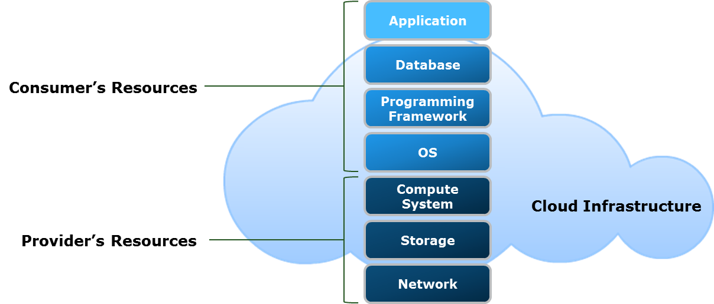
Infrastructure as a Service
Infrastructure as a Service
The capability provided to the consumer is to provision processing, storage, networks, and other fundamental computing resources where the consumer is able to deploy and run arbitrary software, which can include operating systems and applications. The consumer does not manage or control the underlying cloud infrastructure but has control over operating systems, storage, and deployed applications; and possibly limited control of select networking components , (e.g., host firewalls).
– U.S. National Institute of Standards and Technology, Special Publication 800-145
Notes:
Infrastructure as a Service: “The capability provided to the consumer is to provision processing, storage, networks, and other fundamental computing resources where the consumer is able to deploy and run arbitrary software, which can include operating systems and applications. The consumer does not manage or control the underlying cloud infrastructure but has control over operating systems, storage, and deployed applications; and possibly limited control of select networking components (for example, host firewalls).” – NIST
In the IaaS model, consumers hire IT resources, such as compute systems, storage capacity, and network bandwidth from a cloud service provider. The underlying cloud infrastructure is deployed and managed by the cloud service provider. Consumers can deploy and configure software, such as operating system (OS), database, and applications on the cloud resources. Typically the users of IaaS are IT system administrators. IaaS can even be implemented internally by an organization, with internal IT managing the resources and services. IaaS pricing can be subscription-based or based on resource usage. Keeping in line with the cloud characteristics, the provider pools the underlying IT resources and they are shared by multiple consumers through a multi-tenant model.

Slide 23
IaaS cloud servers are typically offered to businesses over the internet, whether through a dashboard or an API, ensuring users have complete control over their computing infrastructure.
Advantages:
you can buy what you need, as you need it, and purchase more as your business grows.
With most IaaS platforms, you get access to ongoing support and have the option of scaling up your requirements at any time.
Example: Amazon Web Services (AWS), Cisco Metapod, Microsoft Azure, Google Compute Engine (GCE)

Slide 24
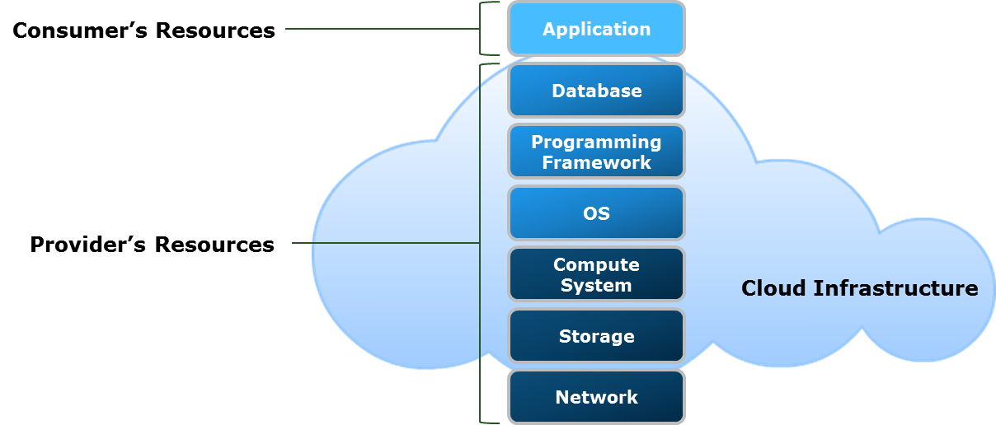
Platform as a Service
Platform as a Service
The capability provided to the consumer is to deploy onto the cloud infrastructure consumer-created or acquired applications created using programming languages, libraries, services, and tools supported by the provider. The consumer does not manage or control the underlying cloud infrastructure including network, servers, operating systems, or storage, but has control over the deployed applications and possibly configuration settings for the application-hosting environment.
– U.S. National Institute of Standards and Technology, Special Publication 800-145
Notes:
Platform as a Service: “The capability provided to the consumer is to deploy onto the cloud infrastructure consumer-created or acquired applications created using programming languages, libraries, services, and tools supported by the provider. The consumer does not manage or control the underlying cloud infrastructure including network, servers, operating systems, or storage, but has control over the deployed applications and possibly configuration settings for the application-hosting environment.” – NIST
In the PaaS model, a cloud service typically includes compute, storage, and network resources along with platform software including an OS, a database, a programming framework, middleware, and tools to develop, test, deploy, and manage applications. PaaS enables application developers to design and develop cloud-based applications using the programming languages, the class libraries, and the tools supported by the provider. PaaS offerings typically enable consumers to build highly-scalable cloud applications that can support a large number of end users. The elasticity and scalability are facilitated transparently by the cloud infrastructure. Moreover, PaaS helps application testers to test the applications in various cloud-based environments. PaaS also enables application deployers to publish or update the applications on the underlying cloud infrastructure. Further, PaaS enables application administrators to configure, monitor, and tune the cloud applications.
Most PaaS offerings are “polyglot” in nature, which means that they support multiple operating systems, programming languages, and frameworks for application development and deployment. PaaS usage fees are typically calculated based on factors, such as the number of consumers, the types of consumers (developer, tester, and so on), the time for which the platform is in use, and the storage, processing, or network resources consumed by the platform. WISA (Windows, Internet Information Services, SQL Server, and ASP.NET) and LAMP (Linux, Apache, MySQL, and PHP/Python/Perl) are examples of solution stacks provided through PaaS for developing and deploying cloud applications.

Slide 25
PaaS provides that platform for software developers to create, allowing them to concentrate on the software itself instead of any external issues.
PaaS platforms are:
Accessible by multiple users.
Scalable — customers can choose from various tiers of computing resources to suit the size of their business.
Built on virtualization technology.
Easy to run without extensive system administration knowledge.

Slide 26
Advantages
A PaaS solution provides the platform for developers to create unique, customizable software meaning that developers don’t need to start from scratch when developing applications — saving them time and money on writing extensive code.
Example:
AWS Elastic Beanstalk, Google App Engine, and Adobe Commerce, Github

Slide 27
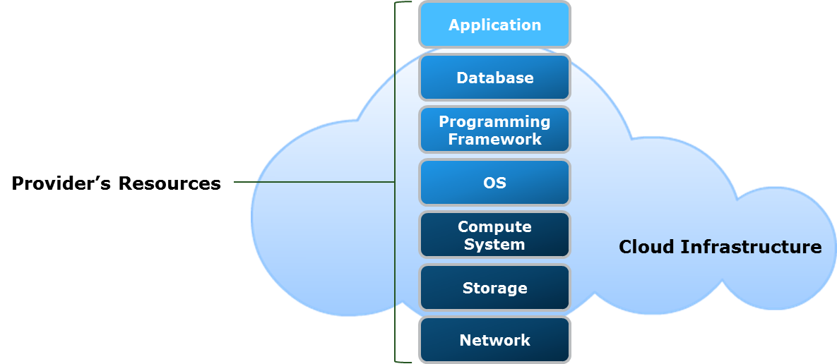
Software as a Service
Software as a Service
The capability provided to the consumer is to use the provider’s applications running on a cloud infrastructure. The applications are accessible from various client devices through either a thin client interface, such as a web browser, (e.g., web-based email, or a program interface. The consumer does not manage or control the underlying cloud infrastructure including network, servers, operating systems, storage, or even individual application capabilities, with the possible exception of limited user-specific application configuration settings.
– U.S. National Institute of Standards and Technology, Special Publication 800-145
Notes:
Software as a Service: “The capability provided to the consumer is to use the provider’s applications running on a cloud infrastructure. The applications are accessible from various client devices through either a thin client interface, such as a web browser (for example, web-based email), or a program interface. The consumer does not manage or control the underlying cloud infrastructure including network, servers, operating systems, storage, or even individual application capabilities, with the possible exception of limited user-specific application configuration settings.” – NIST
In the SaaS model, a provider hosts an application centrally in the cloud and offers it to multiple consumers for use as a service. The consumers do not own or manage any aspect of the cloud infrastructure. In SaaS, a given version of an application, with a specific configuration (hardware and software) typically provides service to multiple consumers by partitioning their individual sessions and data. SaaS applications execute in the cloud and usually do not need installation on end-point devices. This enables a consumer to access the application on demand from any location and use it through a web browser on a variety of end-point devices. Some SaaS applications may require a client interface to be locally installed on an end-point device. Customer Relationship Management (CRM), email, Enterprise Resource Planning (ERP), and office suites are examples of applications delivered through SaaS.

Slide 28
SaaS is delivered through the internet as a full functional service, accessible via any web browser. With SaaS, vendors manage the data, servers and storage, ultimately eliminating the need for IT review and streamlining business processes.
SaaS platforms are:
Available over the Internet.
Hosted on a remote server by a third-party provider.
Ideal for small businesses or startups who cannot develop their own software applications.
Scalable, with different tiers for small, medium and enterprise-level businesses.
Inclusive, offering security, compliance and maintenance as part of the cost.

Slide 29
Advantages
With SaaS, you don’t need to install and run software applications on your computer. Everything is available over the internet when you log in to your account online
Most SaaS providers operate a subscription model with a fixed, inclusive monthly account fee. You know precisely how much the software will cost and can budget accordingly without worrying about hidden surprises.

Slide 30
Cloud Services Brokerage (CSB)
Cloud Services Brokerage
Cloud services brokerage (CSB) is an IT role and business model in which a company or other entity adds value to one or more (public or private) cloud services on behalf of one or more consumers of that service.
– Gartner IT Glossary
CSB is provided by a cloud broker
An entity that acts as an intermediary between cloud consumers and providers
Cloud broker manages the use, performance ,and delivery of cloud services
Notes:
With the continuous evolution of cloud computing, the number of cloud service providers and the service options available to consumers are growing. It is essential for consumers to determine which service provider(s) and cloud service(s) best meet their requirements. In such cases, consumers may need help in navigating, selecting, and implementing cloud services. Moreover, a consumer may utilize cloud services from multiple service providers. The integration of the cloud services may be too complex for cloud consumers to manage. Such issues have led to the emergence of cloud consumption assistance services known as cloud services brokerage.
Gartner, Inc. describes cloud services brokerage (CSB) as “an IT role and business model in which a company or other entity adds value to one or more (public or private) cloud services on behalf of one or more consumers of that service.” (Public and private clouds are discussed in the next lesson). CSB is provided by a cloud broker—an entity that manages the use, performance and delivery of cloud services, and negotiates relationships between cloud providers and cloud consumers. A cloud consumer may request cloud services from a cloud broker, instead of contacting a cloud provider directly. The cloud broker acts as an intermediary between cloud consumers and providers, and helps the consumers through the complexity of cloud service offerings. The cloud broker may also create value-added cloud services. The cloud broker offers combined technology, people, and methodologies to implement and manage CSB-related projects.

Slide 31
Categories of Cloud Services Brokerage
Service intermediation
The broker enhances and adds value to a given service
Service aggregation
The broker combines and integrates multiple services into one or more new services
Service arbitrage
Similar to service aggregation except that the services being aggregated may vary
Notes:
In Special Publication 500-292, NIST describes (citing reports published by Gartner, Inc. as source) that a cloud broker provides services in three categories: service intermediation, service aggregation, and service arbitrage.
Service Intermediation: In service intermediation, a cloud broker enhances a given service by improving some specific capability and providing value-added services to cloud consumers. The improvement can be managing access to cloud services, identity management, performance reporting, enhanced security, and so on. Cloud service intermediation may happen at three points: at the cloud service provider’s location, at the cloud consumer’s location, or as a service in the cloud. Intermediation at the cloud service provider’s location enables the service provider to bundle and distribute a wide array of third-party cloud services along with their own offerings. Intermediation at the cloud consumer’s location allows management and administration of service brokerage locally on the consumer’s site. It enables an organization’s IT to manage the connections with external cloud service providers and to provision services to consumers through an internal portal. In doing so, IT becomes the cloud service broker. The external service is integrated with the organization environment to manage provisioning, security, and billing. This process is called “on-boarding” of the external service in the organization’s environment. Intermediation implemented as a service in the cloud by the broker is true cloud service brokerage. It exists independent of both the cloud service provider and the consumer. The cloud service broker manages the connections and relationships between multiple cloud service providers and cloud consumers.
Service Aggregation: In service aggregation, a cloud broker combines multiple cloud services into one or more services. This form of brokerage service ensures that the data is modeled and integrated across all component cloud services. It also ensures that data movement between a cloud consumer and multiple cloud service providers is secure. Once established, such brokered services are usually fixed and do not change often. Service aggregation forms a composite service layer that is similar to the application layer in traditional computing.
(Cont'd)

Slide 32
Categories of Cloud Services Brokerage
Service intermediation
The broker enhances and adds value to a given service
Service aggregation
The broker combines and integrates multiple services into one or more new services
Service arbitrage
Similar to service aggregation except that the services being aggregated may vary
Notes:
Service Arbitrage: Service arbitrage is similar to service aggregation, with the exception that the services being aggregated may vary. For example, a single service provider may provide multiple e-mail services through a common interface, wherein the number and type of e-mail services may vary. In the cloud service arbitrage approach, the cloud broker has a degree of flexibility and adaptable choices while providing services to the consumers. Additionally, the consumers gain the flexibility to choose between multiple similar services.

Slide 33
Introduction to Cloud Deployment Models
A cloud deployment model specifies how a cloud infrastructure is built, managed, and accessed
NIST specifies four primary cloud deployment models:
Public
Private
Community
Hybrid
Notes:
A cloud deployment model provides a basis for how cloud infrastructure is built, managed, and accessed. In SP 800-145, NIST specifies the four primary cloud deployment models listed below:
Public cloud
Private cloud
Hybrid cloud
Community cloud
Each cloud deployment model may be used for any of the cloud service models: IaaS, PaaS, and SaaS. The different deployment models present a number of tradeoffs in terms of control, scale, cost, and availability of resources.

Slide 34
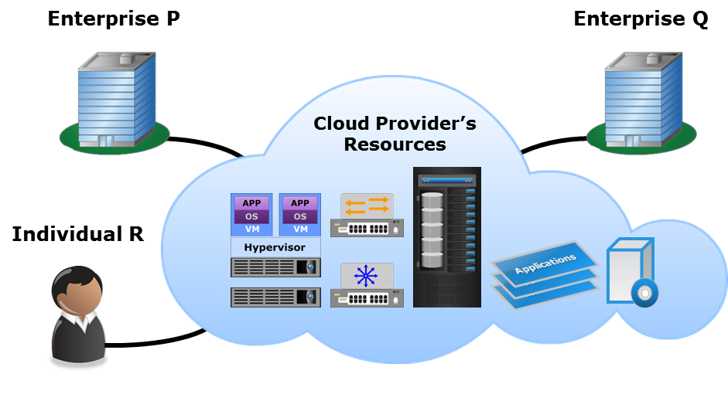
Public Cloud
Public Cloud
The cloud infrastructure is provisioned for open use by the general public. It may be owned, managed, and operated by a business, academic, or government organization, or some combination of them. It exists on the premises of the cloud provider.
– U.S. National Institute of Standards and Technology, Special Publication 800-145
Notes:
Public cloud: “The cloud infrastructure is provisioned for open use by the general public. It may be owned, managed, and operated by a business, academic, or government organization, or some combination of them. It exists on the premises of the cloud provider.” – NIST
A public cloud is a cloud infrastructure deployed by a provider to offer cloud services to the general public and/or organizations over the Internet. In the public cloud model, there may be multiple tenants (consumers) who share common cloud resources. A provider typically has default service levels for all consumers of the public cloud. The provider may migrate a consumer’s workload at any time and to any location. Some providers may optionally provide features that enable a consumer to configure their account with specific location restrictions. Public cloud services may be free, subscription-based or provided on a pay-per-use model.
Public cloud provides the benefits of low up-front expenditure on IT resources and enormous scalability. However, some concerns for the consumers include network availability, risks associated with multi-tenancy, limited or no visibility and control over the cloud resources and data, and restrictive default service levels.
The figure on the slide illustrates a generic public cloud that is available to enterprises and to individuals. The figure includes some virtual components for relevance and accuracy. The virtual components are described later in ‘Virtual Layer’ module.

Slide 35
Private Cloud
Private Cloud
The cloud infrastructure is provisioned for exclusive use by a single organization comprising multiple consumers (for example, business units). It may be owned, managed, and operated by the organization, a third party, or some combination of them, and it may exist on or off premises.
– U.S. National Institute of Standards and Technology, Special Publication 800-145
There are two variants of private cloud:
On-premise
Externally-hosted
Notes:
Private cloud: “The cloud infrastructure is provisioned for exclusive use by a single organization comprising multiple consumers (for example, business units). It may be owned, managed, and operated by the organization, a third party, or some combination of them, and it may exist on or off premises.” – NIST
A private cloud is a cloud infrastructure that is set up for the sole use of a particular organization. The cloud services implemented on the private cloud are dedicated to consumers, such as the departments and business units within the organization. Many organizations may not wish to adopt public clouds as they are accessed over the open Internet and used by the general public. With a public cloud, an organization may have concerns related to privacy, external threats, and lack of control over the IT resources and data. When compared to a public cloud, a private cloud offers organizations a greater degree of privacy, and control over the cloud infrastructure, applications, and data. The private cloud model is typically adopted by larger-sized organizations that have the resources to deploy and operate private clouds.
There are two variants of a private cloud: on-premise and externally-hosted.

Slide 36
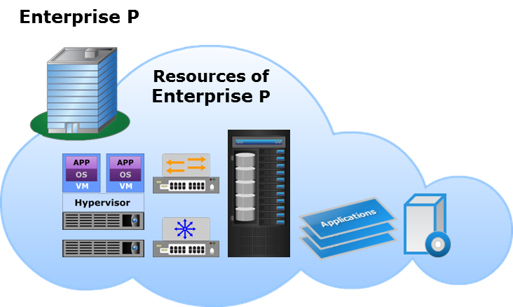
On-premise Private Cloud
Cloud infrastructure is deployed by an organization on its data centers within its premises
Provides complete control over the infrastructure and data
Enables standardization of IT resources, processes, and services
Notes:
The on-premise private cloud, also known as an internal cloud, is hosted by an organization on its data centers within its own premises. The on-premise private cloud model enables an organization to have complete control over the infrastructure and data. In this model, the organization’s IT department is typically the cloud service provider. In some cases, a private cloud may also span across multiple sites of an organization, with the sites interconnected via a secure network connection.
The on-premise private cloud model enables an organization to standardize IT resources, management processes, and cloud services. Standardization simplifies the private cloud environment and the infrastructure management process, and creates an opportunity to save operational costs. It reduces the variation in the hardware and software components used for the private cloud deployment. Standardization is typically achieved by using compatible products for technology components, such as compute, storage, networking or management. Standardization also helps in automation of resource and service management. Automation eliminates the need for IT to perform repetitive manual processes and tasks associated with activities, such as configuration and provisioning. However, not all automation products are fully compatible with all hardware. In such cases, a standardized environment may reduce the amount of customization and integration required to implement automation.
Organizations choosing the on-premise private cloud approach would incur significant CAPEX for the IT resources as compared to the public cloud approach. This may give rise to challenges regarding infrastructure size and resource scalability. The on-premise private cloud model is best suited for organizations that require complete control over their infrastructure, resource configurations, applications, data, and security mechanisms.

Slide 37
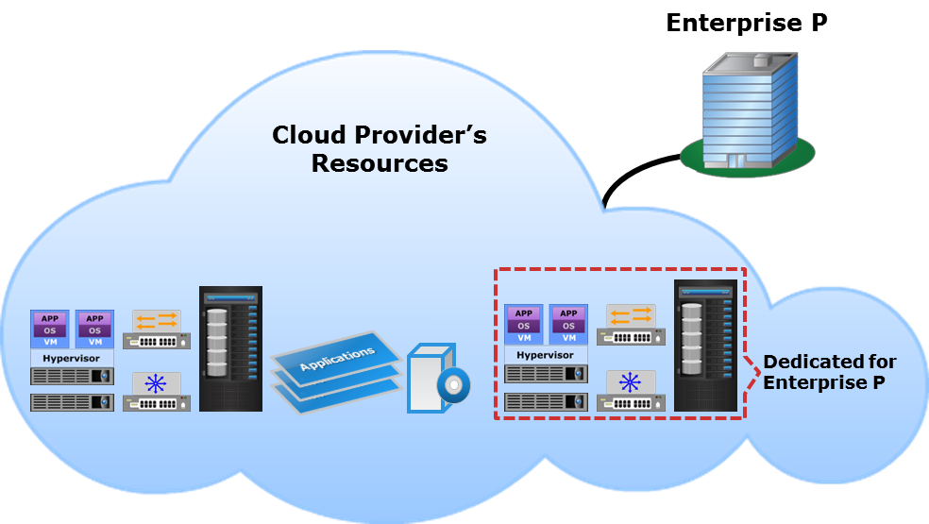
Externally-hosted Private Cloud
Cloud implementation is outsourced to an external provider
Cloud is hosted on the provider’s premises and the consumers connect to it over a secure network
Access policies isolate the cloud resources from other tenants
Notes:
In the externally-hosted private cloud model, an organization outsources the implementation of the private cloud to an external cloud service provider. The cloud infrastructure is hosted on the premises of the external provider and not within the consumer organization’s premises. The provider manages the cloud infrastructure and facilitates an exclusive private cloud environment for the organization.
The organization’s IT infrastructure connects to the externally-hosted private cloud over a secure network. The provider enforces security mechanisms in the private cloud per the consumer organization’s security requirements. In this model, the cloud infrastructure may be shared by multiple tenants. However, the provider has a security perimeter around the private cloud resources of the consumer organization. The organization’s private cloud resources are separated from other cloud tenants by access policies implemented by the provider’s software. A number of possible mechanisms can be used to maintain this separation and protect against threats. These are discussed later in ‘Security’ module.
Organizations choosing the externally-hosted private cloud model can save on the CAPEX associated with IT resources, such as compute systems, storage systems, and other supporting infrastructure. Also, an organization can hire cloud resources in any quantity from the provider, unlike the on-premise private cloud model, in which the resources must be provisioned by the organization up front.

Slide 38
Community Cloud
Community Cloud
The cloud infrastructure is provisioned for exclusive use by a specific community of consumers from organizations that have shared concerns (e.g., mission, security requirements, policy, and compliance considerations). It may be owned, managed, and operated by one or more of the organizations in the community, a third party, or some combination of them, and it may exist on or off premises.
– U.S. National Institute of Standards and Technology, Special Publication 800-145
There are two variants of community cloud:
On-premise
Externally-hosted
Notes:
Community cloud: “The cloud infrastructure is provisioned for exclusive use by a specific community of consumers from organizations that have shared concerns (for example, mission, security requirements, policy, and compliance considerations). It may be owned, managed, and operated by one or more of the organizations in the community, a third party, or some combination of them, and it may exist on or off premises.” – NIST
A community cloud is a cloud infrastructure that is set up for the sole use by a group of organizations with common goals or requirements. The organizations participating in the community typically share the cost of the community cloud service. If various organizations operate under common guidelines and have similar requirements, they could all share the same cloud infrastructure and lower their individual investments. Since the costs are shared by fewer consumers than in a public cloud, this option may be more expensive. However, a community cloud may offer a higher level of control and protection against external threats than a public cloud.
There are two variants of a community cloud: on-premise and externally-hosted.

Slide 39
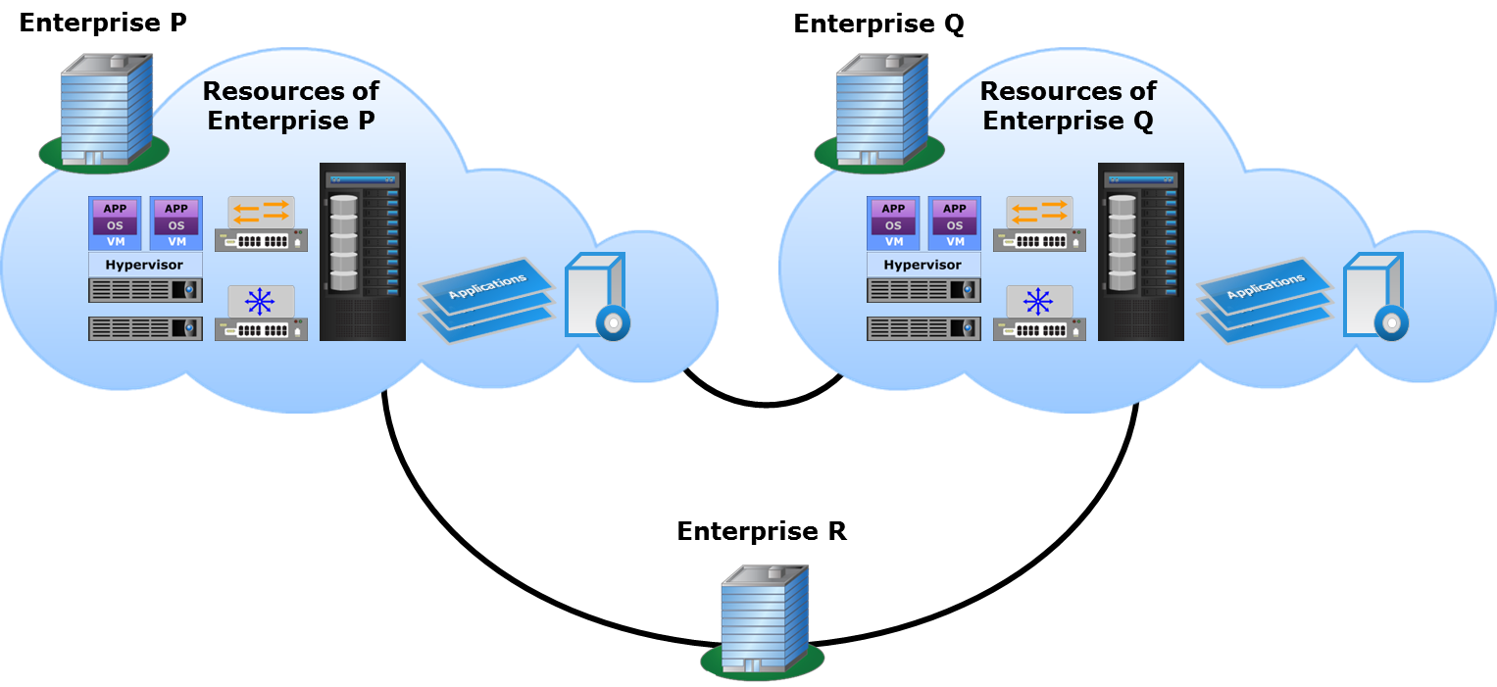
On-premise Community Cloud
Notes:
In an on-premise community cloud, one or more participant organizations provide cloud services that are consumed by the community. Each participant organization may provide cloud services, consume services, or both. At least one community member must provide cloud services for the community cloud to be functional. The cloud infrastructure is deployed on the premises of the participant organization(s) providing the cloud services. The organizations consuming the cloud services connect to the clouds of the provider organizations over a secure network. The organizations providing cloud services require IT personnel to manage the community cloud infrastructure. Participant organizations that provide cloud services may implement a security perimeter around their cloud resources to separate them from their other non-cloud IT resources. Additionally, the organizations that consume community cloud services may also implement a security perimeter around their IT resources that access the community cloud.
Many network configurations are possible in a community cloud. The figure on the slide illustrates an on-premise community cloud, the services of which are consumed by enterprises P, Q, and R. The community cloud comprises two cloud infrastructures that are deployed on the premises of Enterprise P and Enterprise Q, and combined to form a community cloud.

Slide 40
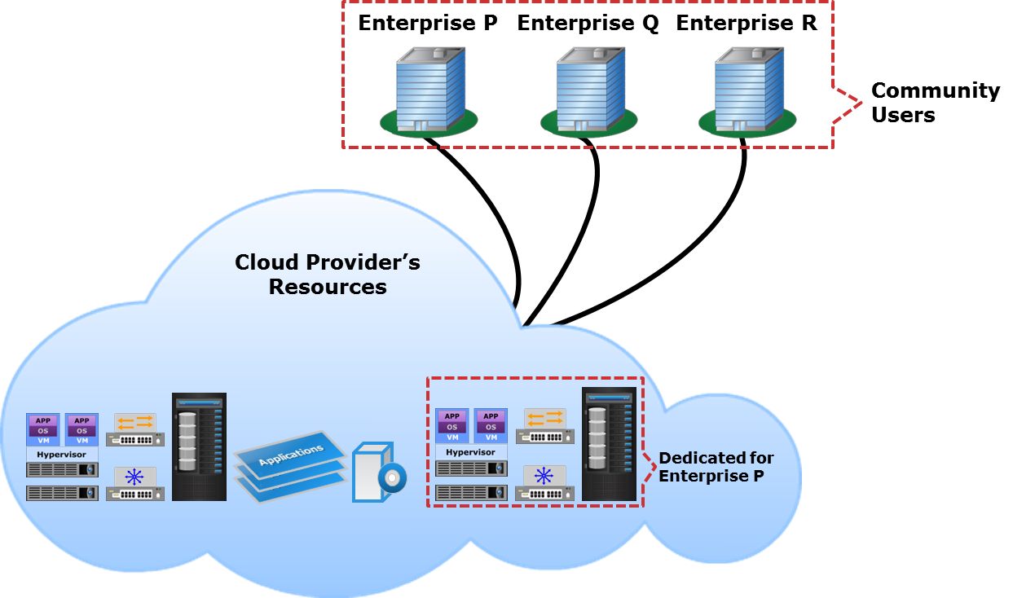
Externally-hosted Community Cloud
Notes:
In the externally-hosted community cloud model, the participant organizations of the community outsource the implementation of the community cloud to an external cloud service provider. The cloud infrastructure is hosted on the premises of the external cloud service provider and not within the premises of any of the participant organizations. The provider manages the cloud infrastructure and facilitates an exclusive community cloud environment for the participant organizations.
The IT infrastructure of each of the participant organizations connects to the externally-hosted community cloud over a secure network. The provider enforces security mechanisms in the community cloud as per the requirements of the participant organizations. In this model, the cloud infrastructure may be shared by multiple tenants. However, the provider has a security perimeter around the community cloud resources and they are separated from other cloud tenants by access policies implemented by the provider’s software.
Unlike an on-premise community cloud, the participant organizations can save on the up-front costs of IT resources in case of an externally-hosted community cloud. Also, using an external provider’s cloud infrastructure for the community cloud may offer access to a larger pool of resources as compared to an on-premise community cloud.

Slide 41
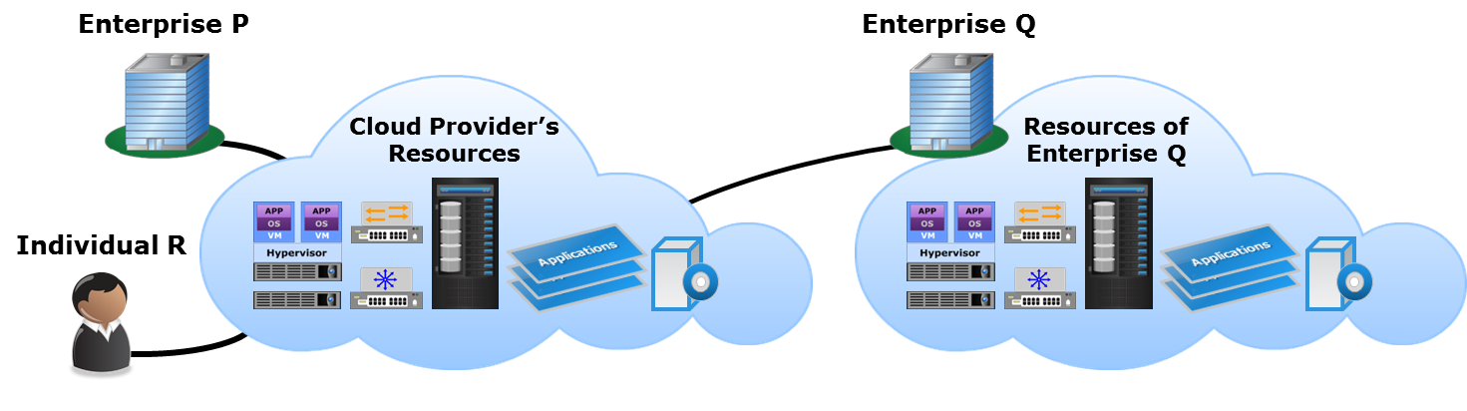
Hybrid Cloud
Hybrid Cloud
The cloud infrastructure is a composition of two or more distinct cloud infrastructures (private, community, or public) that remain unique entities, but are bound together by standardized or proprietary technology that enables data and application portability (e.g., cloud bursting for load balancing between clouds).
– U.S. National Institute of Standards and Technology, Special Publication 800-145
Notes:
“The cloud infrastructure is a composition of two or more distinct cloud infrastructures (private, community, or public) that remain unique entities, but are bound by standardized or proprietary technology that enables data and application portability (for example, cloud bursting for load balancing between clouds.)” – NIST
A hybrid cloud is composed of two or more individual clouds, each of which can be private, community, or public clouds. There can be several possible compositions of a hybrid cloud as each constituent cloud may be of one of the five variants as discussed previously. As a result, each hybrid cloud has different properties in terms of parameters, such as performance, cost, security, and so on. A hybrid cloud may change over time as component clouds join and leave. In a hybrid cloud environment, the component clouds are combined through the use of open or proprietary technology, such as interoperable standards, architectures, protocols, data formats, application programming interfaces (APIs), and so on. The use of such technology enables data and application portability. The figure on the slide illustrates a hybrid cloud that is composed of an on-premise private cloud deployed by enterprise Q and a public cloud serving enterprise and individual consumers in addition to enterprise Q.

Slide 42
Hybrid Cloud Model Use Cases
Use case | Description
Cloud bursting | Provisioning resources for a limited time from a public cloud to handle peak workloads
Web application hosting | Hosting less critical applications such as e-commerce applications on the public cloud
Migrating packaged applications | Migrating standard packaged applications such as email to the public cloud
Application development and testing | Developing and testing applications in the public cloud before launching them
Notes:
The hybrid cloud has become the model of choice for many organizations. Some use cases of the hybrid cloud model are discussed below.
Cloud bursting: A common usage scenario of a hybrid cloud is “cloud bursting”, in which an organization uses a private cloud for normal workloads, but optionally accesses a public cloud to meet transient higher workload requirements. Cloud bursting allows consumers to temporarily obtain public cloud resources in a convenient and cost-effective manner, and to enjoy a greater elasticity than their own infrastructure would permit. For example, an application may encounter a surge in workload during certain periods and would require additional resources to handle the workload efficiently. The application can get additional resources from a public cloud for a limited time period to handle the higher workload.
Web application hosting: Organizations may host mission-critical applications on a private cloud, while less critical applications are hosted on a public cloud. By deploying less critical applications in the public cloud, an organization can leverage the scalability and cost benefits of the public cloud. For example, e-commerce applications, such as online retail stores are often three-tier applications that use public-facing web assets outside the firewall and business-critical assets onsite. These applications can be hosted in the public cloud. Also, such applications typically have dynamic and unpredictable resource requirements, which can be difficult to plan for when hosting them in an organization’s private cloud. As mentioned in the cloud bursting use case, such applications can get additional capacity on-demand from the public cloud for a limited time period.
Packaged applications: An organization may migrate standard packaged applications, such as email and collaboration software out of the private cloud to a public cloud. This frees up existing resources for higher value projects and applications. In some cases, the existing applications may have to be rewritten and/or reconfigured for the public cloud platform. However, dedicated hybrid cloud services enable existing applications to run in the hybrid cloud without the need to rewrite or re-architect them.
(Cont'd)

Slide 43
Hybrid Cloud Model Use Cases
Use case | Description
Cloud bursting | Provisioning resources for a limited time from a public cloud to handle peak workloads
Web application hosting | Hosting less critical applications such as e-commerce applications on the public cloud
Migrating packaged applications | Migrating standard packaged applications such as email to the public cloud
Application development and testing | Developing and testing applications in the public cloud before launching them
Notes:
Application development and testing: As discussed in the section on ‘Cloud Computing Benefits’, organizations require significant capital expenditure on IT resources while developing and testing new applications. Also, the applications need to be tested for scalability and under heavy workload, which might require a large amount of IT resources for a short period of time. Further, if the longevity of the application is limited, it would not justify the expenditure made in developing it. In such cases, organizations may use public cloud resources for the development and testing of applications, before incurring the capital expenditure associated with launching it. Once the organization establishes a steady-state workload pattern and the longevity of the application, it may choose to bring the application into the private cloud environment.

Slide 44
Lesson Summary
During this lesson the following topics were covered:
Public cloud
Private cloud: on-premise and externally-hosted
Community cloud: on-premise and externally-hosted
Hybrid cloud and its use cases
Notes:
This lesson covered the four primary cloud deployment models: public cloud, private cloud, community cloud, and hybrid cloud.
In a public cloud model, the provider provisions the cloud infrastructure for open use by the general public. In a private cloud model, the cloud infrastructure is provisioned for exclusive use by consumers within a single organization. There are two variants of a private cloud: on-premise and externally-hosted. A community cloud is deployed for exclusive use by consumers in organizations that have shared concerns. There are two variants of a community cloud: on-premise and externally-hosted. A hybrid cloud is a composition of two or more distinct cloud infrastructures bound together by standardized or proprietary technology.

